Slide 1
Connecting Microburst Precipitation to Its Scattering Mechanism
Mykhaylo (Mike) Shumko
October 16th, 2019
Dissertation Defense
Notes:
Thank you for coming to my defense this early in the day
Today I will talk about connecting microburst observations to the waves believed to scatter them

Slide 2
Outline
Introduction
Magnetosphere
Radiation belt particles and waves
Microburst precipitation
Estimate the microburst size distribution and compare it to the waves believed to generate microbursts
Case study with FIREBIRD-II
Statistical study with AeroCube-6
Model microbursts observed in the heart of the outer radiation belt
Paths forward
Notes:
In the introduction I will lay the groundwork and discuss the magnetosphere as a whole.
Then I will introduce one particle population – the Van Allen Radiation Belts.
Then I will discuss the whistler mode chorus wave, a wave in the radiation belts, believed to be responsible for scattering microbursts.
I will derive a simple wave-particle scattering model to motivate microburst precipitation.
Then I will showcase a few studies that I’ve done over the my grad school career to understand how microbursts are scattered by estimating the sizes of microbursts from low Earth orbit with the FIREBIRD and AC-6 CubeSats, and then model microbursts discovered in the heart of the radiation belt.
Lastly, I will mention a few follow on studies that can be done in the future

Slide 3
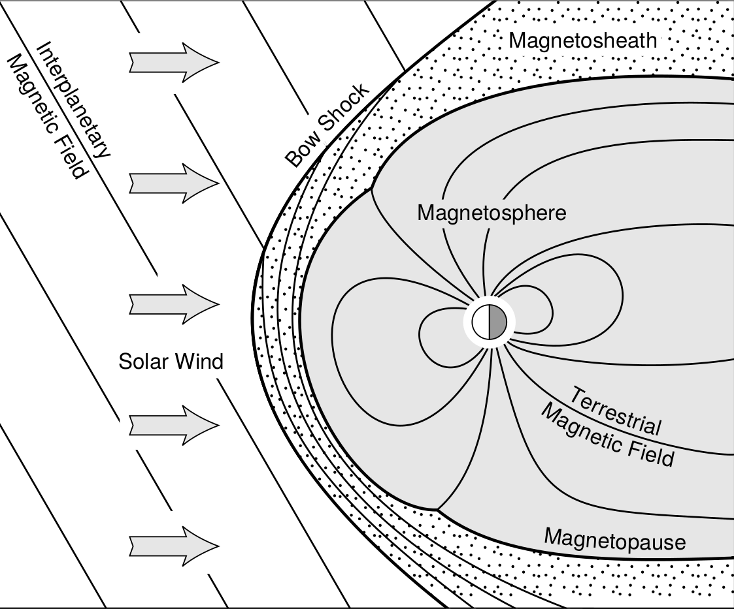
The magnetosphere
Baumjohann and Treumann 1997
Notes:
Mention the structures left to right.
Solar wind travels to the right. In its frame of reference the Earth is an obstacle moving towards it at supersonic speeds.
The solar wind encounters the bow shock which compresses and heats the solar wind plasma which then flows around the magnetosphere in the magnetosheath. The boundary between the solar wind plasma and the magnetosphere is the magnetopause. Earth’s magnetic field is contained by the magnetopause.
The region most relevant to my work is the inner magnetosphere…

Slide 4
The magnetosphere
Baumjohann and Treumann 1997
Notes:
Which houses a various particle populations who’s dynamics are mainly controlled by Earth’s nearly dipolar magnetic field.

Slide 5
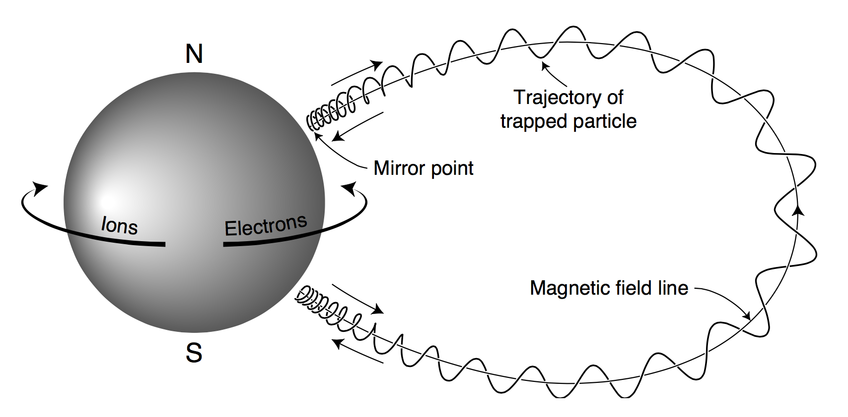
Charged particle motion in Earth’s magnetic field
Dipole magnetic field is the dominant component
Charged particles exhibit three type of motion from the Lorentz force that have corresponding adiabatic invariants
Gyro motion ~ 1 kHz
Bounce motion ~ 1 Hz
Drift motion ~ 1 mHz
Violation of these invariants lead to many non-linear phenomena.
Baumjohann and Treumann 1997
Notes:
Charged particles exhibit three periodic motions from the Lorentz force. Each have a correpsoding adiabatic invarient
In order from highest to lowest frequency:
Gyration is the highest frequency and you all learned this in intro physics.
Bounce motion arises because Earth’s field is stronger near the poles and particles feel a force a way from the poles. In the next slide I will introduce the pitch angle which defines how far down the field line a particle can travel before it stops and reverses direction.
Drift motion arises from the curvature and radial gradient of B that makes electrons orbit east and ions drift west.
The dynamics that are actively studied involve violation of these adiabatic invariants. These invariants are violated when a force acts at or near the frequency of the periodic motion. For example, chorus waves have frequencies on the order of the gyrofrequency so the gyro motion – as well as the two other periodic motions – are violated.

Slide 6
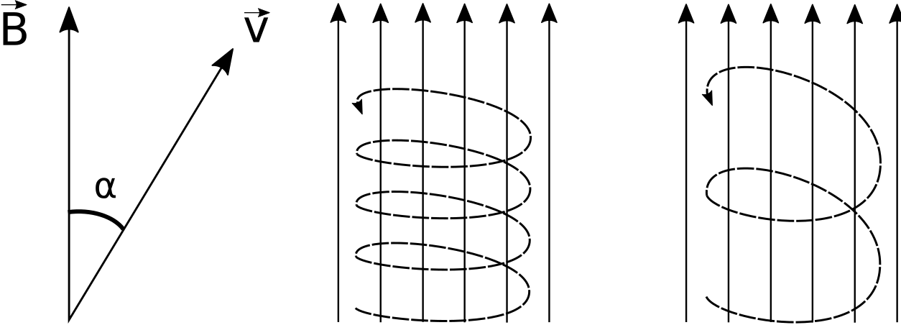
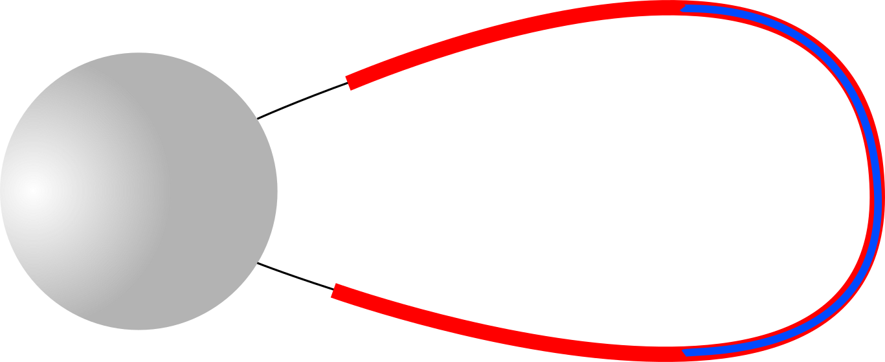
Particle's Pitch Angle, α
large α
small α
Angle between the local magnetic field and the velocity vectors
A particle with a large α will mirror closer to the magnetic equator relative to a smaller α
Particles with a small α that enter Earth’s atmosphere are considered to be in the loss cone
Baumjohann and Treumann 1997
Notes:
A good reference point for α is at the magnetic equator, but that is just one choice.
A smaller α particle can go closer towards the Earth.
In LEO, where the two CubeSat missions operate, the equatorial pitch angle is only a few degrees. Microbursts are scattered to those αs.

Slide 7
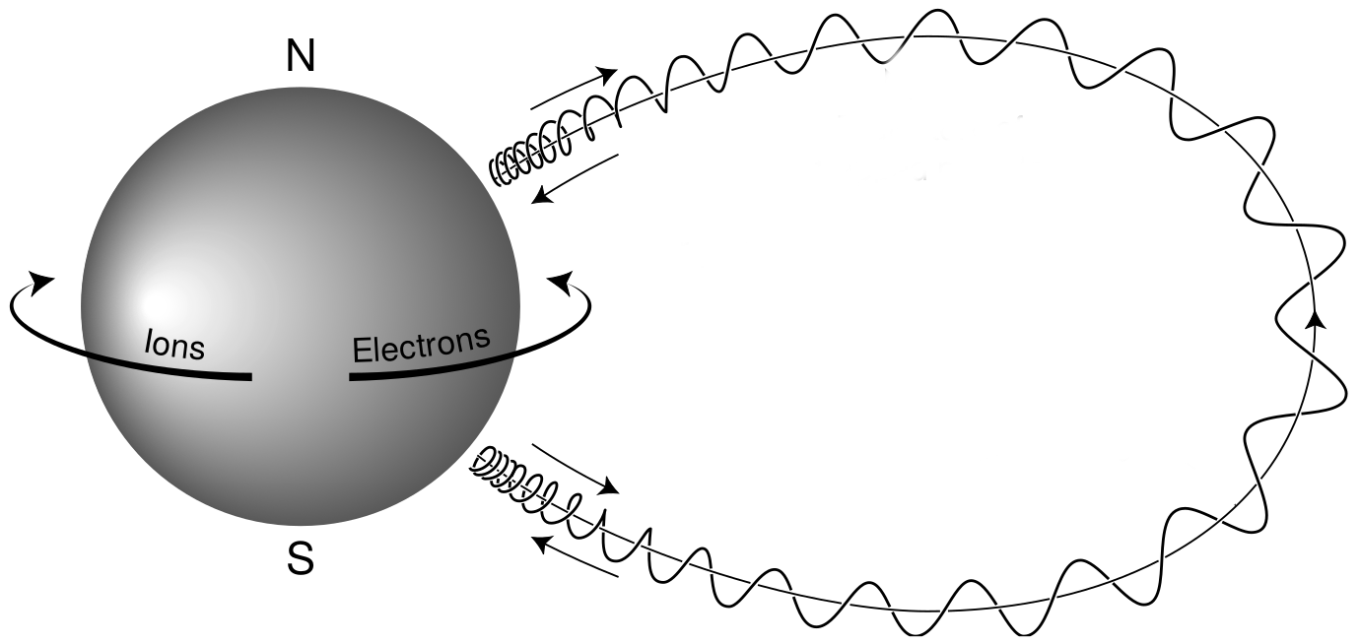
Particle's Pitch Angle, α
large α
small α
Angle between the local magnetic field and the velocity vectors
A particle with a large α will mirror closer to the magnetic equator relative to a smaller α
Particles with a small α that enter Earth’s atmosphere are considered to be in the loss cone
Baumjohann and Treumann 1997
Notes:
A good reference point for α is at the magnetic equator, but that is just one choice.
A smaller α particle can go closer towards the Earth.
In LEO, where the two CubeSat missions operate, the equatorial pitch angle is only a few degrees. Microbursts are scattered to those αs.

Slide 8
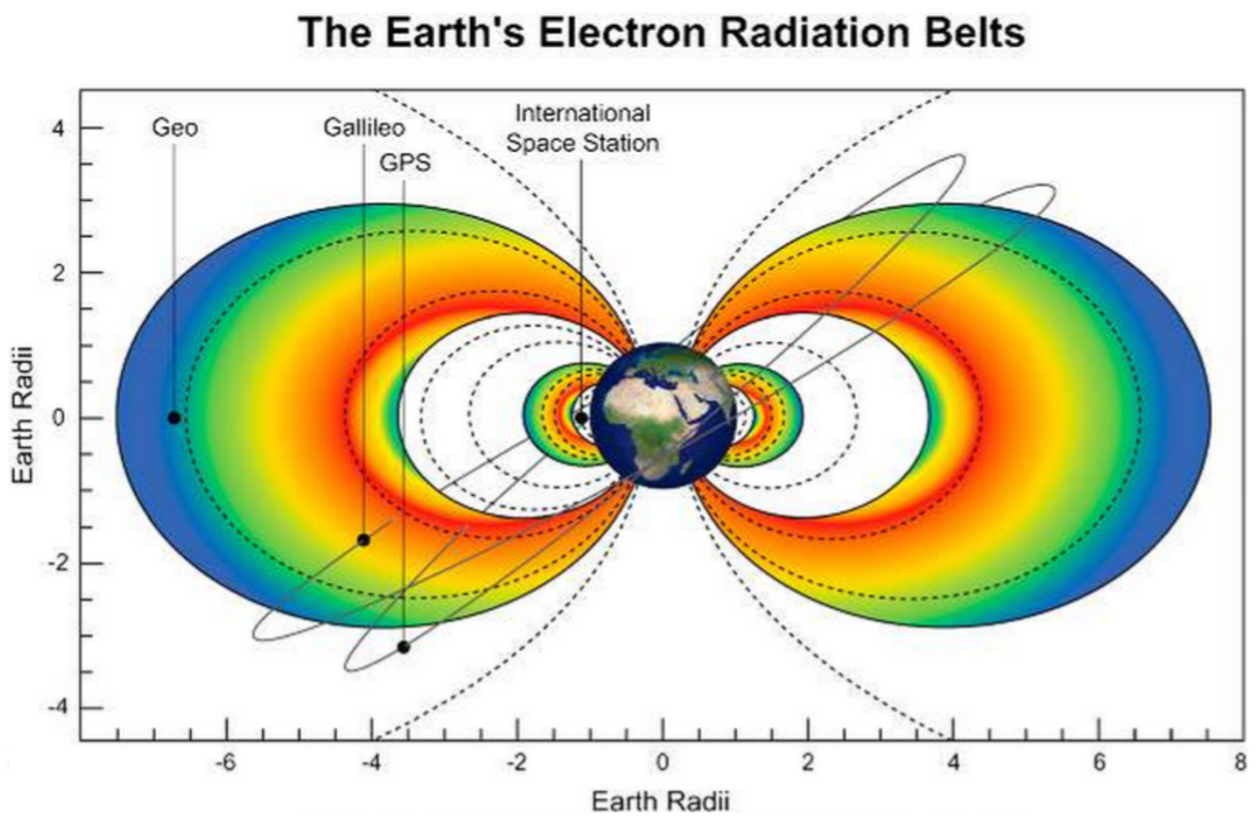
Outer Van Allen Radiation Belt
Energy: 100 – 1000s keV e⁻
Composition: mostly e⁻
Source: particle injections followed by wave acceleration
Extent: 4 < L < 8
Horne et al., 2013
Notes:
In the inner magnetosphere these particles are organized into the plasmasphere, ring current, and the most relevant population – the radiation belts.
Consists of two belts, inner and outer separated by the slot region. << GO THROUGH FACTS >>.
Mention L shell after the inner belt. Defines a magnetic field line that intersects the magnetic equator at L Earth radii away from Earth.
Mention that during a radiation belt pass the LEO CubeSat (500ish km) passes through those field lines connecting to the radiation belt.

Slide 9
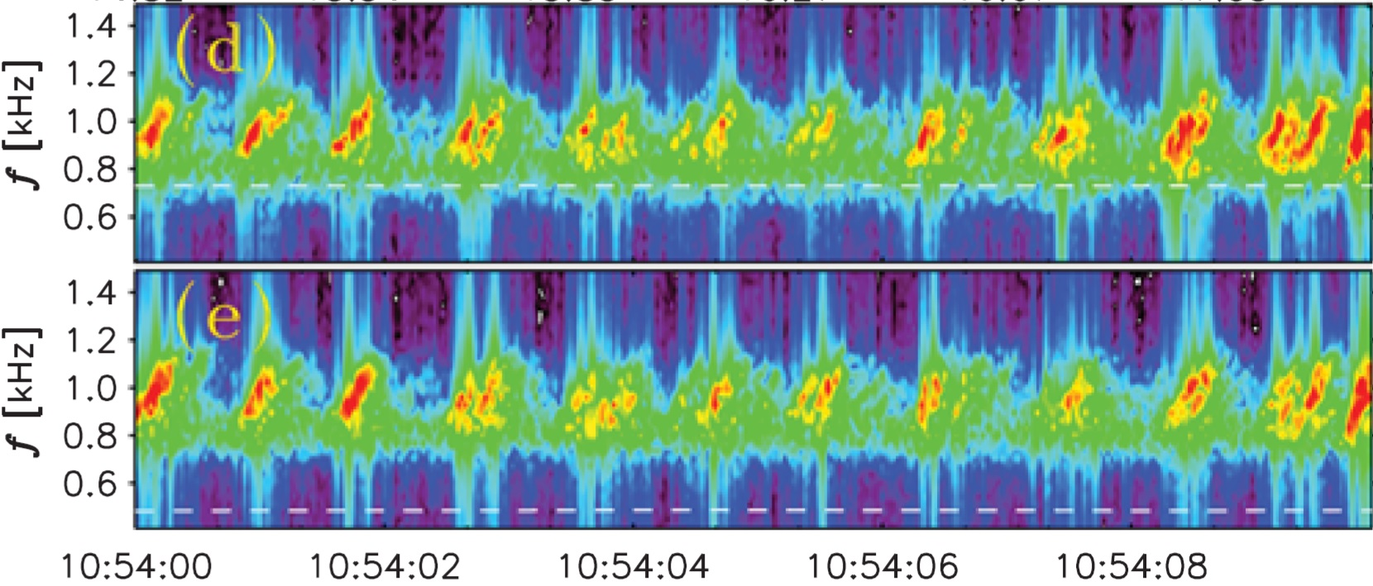

Whistler-mode Chorus Waves
Figure from Agapitov et al. 2017
Audio from the EMFISIS team (NASA/University of Iowa)
Notes:
One type of wave is chorus and here is a spectrogram of some from Oleksiy’s work.
The reason they are whistler mode is because of their audible sound << PLAY SOUND >>. You can hear it without modification.
Rising tone elements have a ~100 ms duration which will be important later
Chorus waves are circularly polarized
Exist in two frequency bands relative to the electron gyrofrequency

Slide 10
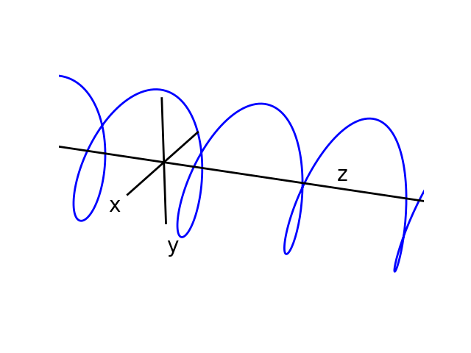
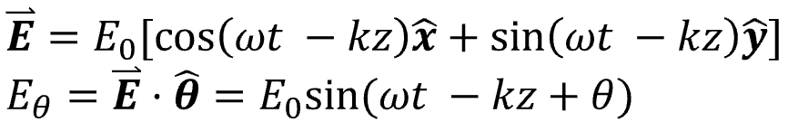
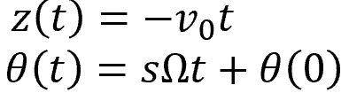
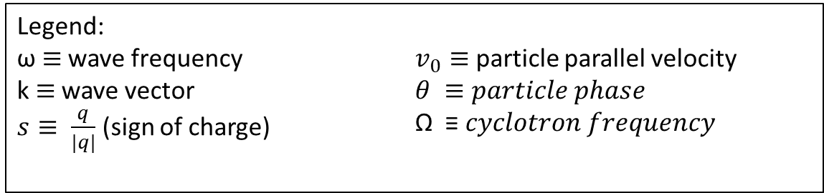
Toy model of wave-particle scattering with field-aligned wave
Assume a circularly polarized wave traveling along the background magnetic field in the z direction.
x
Also assume the electron is gyrating in the x-y plane with a velocity in the –z direction.
y
Legend:
ω $≡$ wave frequency
k $≡$ wave vector
$s≡ \frac{q}{|q|}$ (sign of charge)
$v_{0}≡$ particle parallel velocity
$θ ≡particle phase$
Ω ≡ 𝑐𝑦𝑐𝑙𝑜𝑡𝑟𝑜𝑛 𝑓𝑟𝑒𝑞𝑢𝑒𝑛𝑐𝑦
Notes:
Now I am going to derive a very simple toy model to understand how waves and particles interact. Talk about this very fast.
Assume you have a background magnetic field pointing in the z axis and a RH circularly polarized electric field also traveling in the z direction. Wave frequency is w, on the order of gyrofrequency, and wave vector is k.
We can look at one component, E_ϴ, to see how it accelerates an electron.
Now assume a particle is gyrating about the background field and is traveling in the –z direction for reasons that will be explained in the next slide.

Slide 11
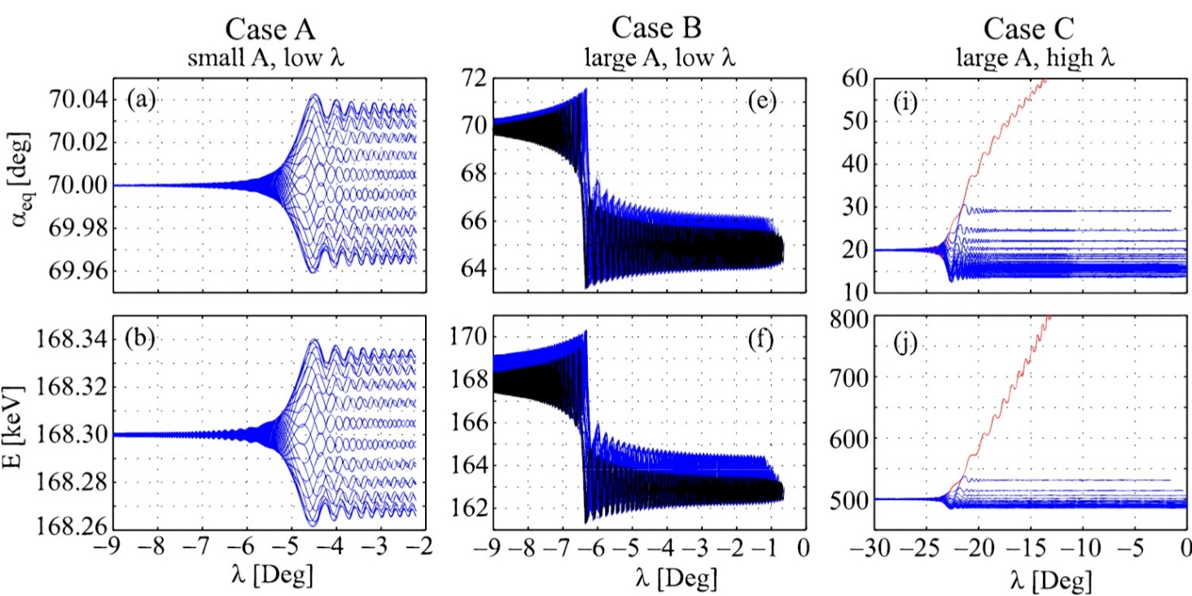
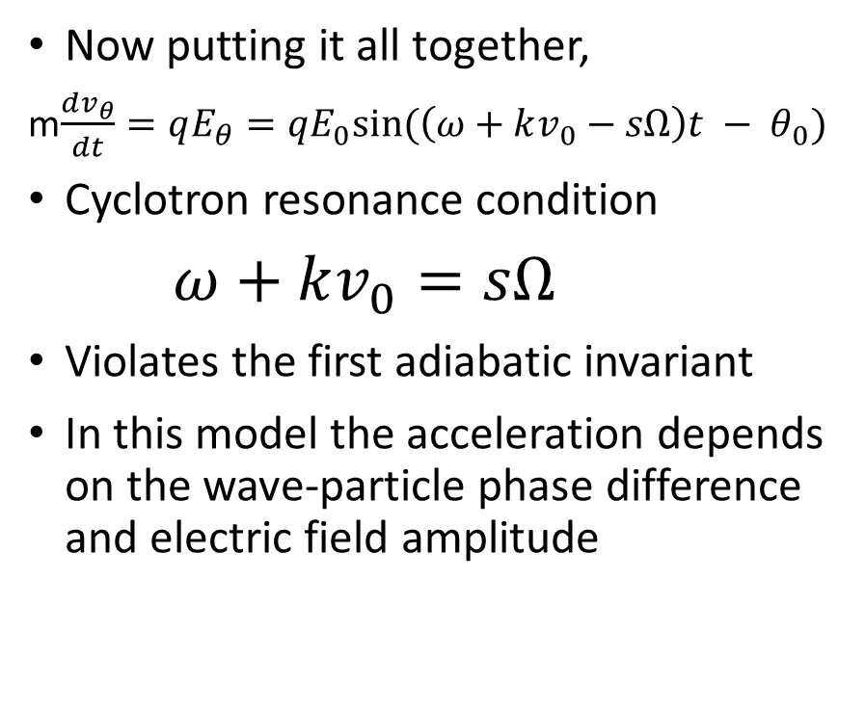
Toy model of wave-particle scattering (cont)
Now putting it all together,
m$\frac{dv_{θ}}{dt}=qE_{θ}=qE_{0}sin⁡(\left(ω+kv_{0}−sΩ\right)t − θ_{0})$
Cyclotron resonance condition
$ω+kv_{0}=sΩ$
Violates the first adiabatic invariant
In this model the acceleration depends on the wave-particle phase difference and electric field amplitude
Bortnik et al. 2008
Notes:
What force will the electron feel? Use the Lorentz eq. and isolate the time dependent term.
When it is 0 the particle will feel a static E field and be accelerated or decelerated.
Since w is on the order, but smaller than the gyrofrequency, the k*v term Doppler shifts the wave frequency to the gyrofrequency.
The Bortnik paper shows example of how electrons with different phases scatter given different wave amplitudes and wavelengths.
Case A shows diffusive transport, and Cases B & C show non-linear transport
One manifestation of wave-particle scattering are microbursts

Slide 12
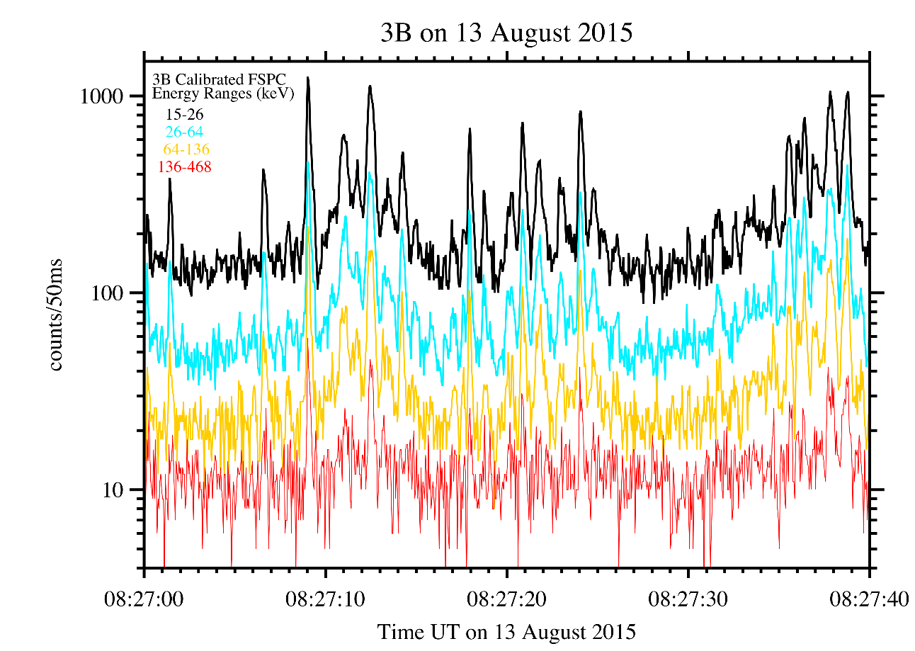
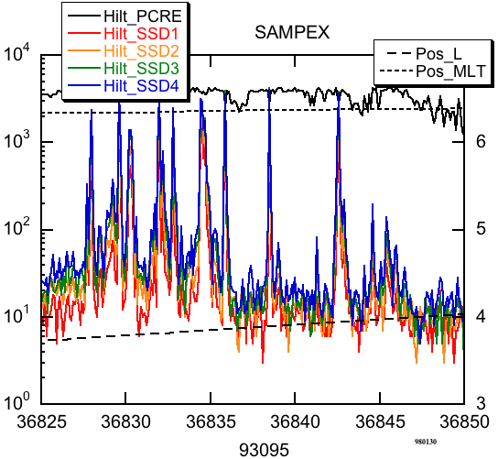
Electron Microbursts
One manifestation of wave-particle interactions are microbursts
Microbursts are a < 1 second intense bursts of electrons into the atmosphere
Microburst duration similar to chorus rising tone
First reported by Anderson and Milton 1964
Observed with a high altitude balloon
Observed by LEO spacecraft
Studies show that microbursts can
deplete the outer radiation belt electrons on the order of hours to days
influence atmospheric chemistry
Anderson et al., 2015
Blake et al., 1996
Notes:
Microbursts are a sub-second intense impulse of electrons, typically a few hundred ms in duration.
<< BASICALLY READ SLIDES >>
Two examples shown on the right from a BARREL balloon campaign (top) and the SAMPEX satellite (bottom).
Short duration and order of magnitude increase in electron flux makes them interesting to study. Have been shown to deplete rad belt and influence atmospheric chemistry.
Now lets look at some properties of microbursts

Slide 13
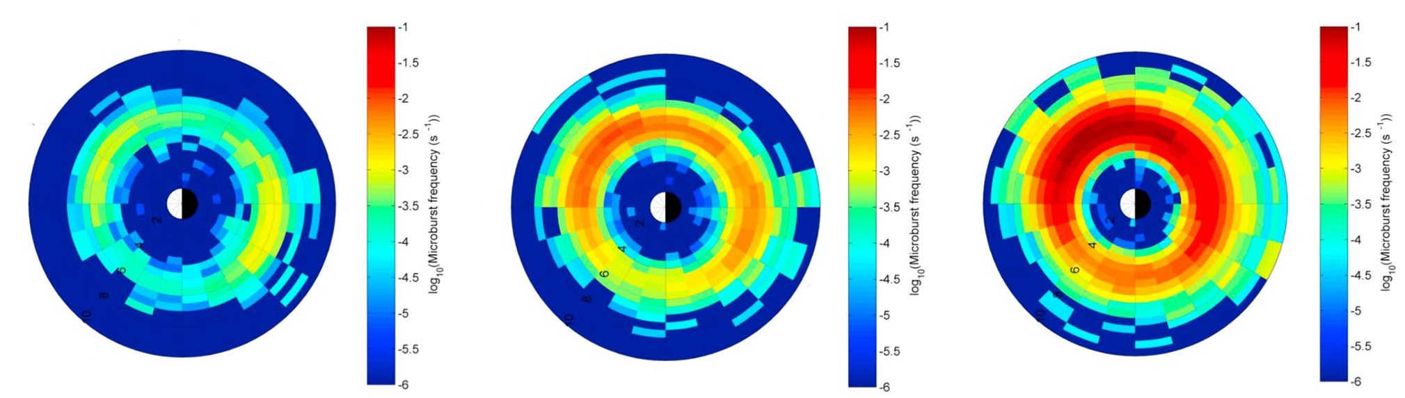
Electron Microbursts (cont)
Douma et al., 2017
Microbursts are observed under the outer radiation belt footprints (4 < L < 8)
In the 0-12 magnetic local time
Occur more frequently when the magnetosphere is disturbed
Notes:
Here is a dial plot which shows the L and MLT locations of microbursts. << EXPLAIN THAT L IS RADIAL, and MLT IS AZIMUTHAL >>
How about the waves? The best candidate for scattering microbursts are chorus waves

Slide 14
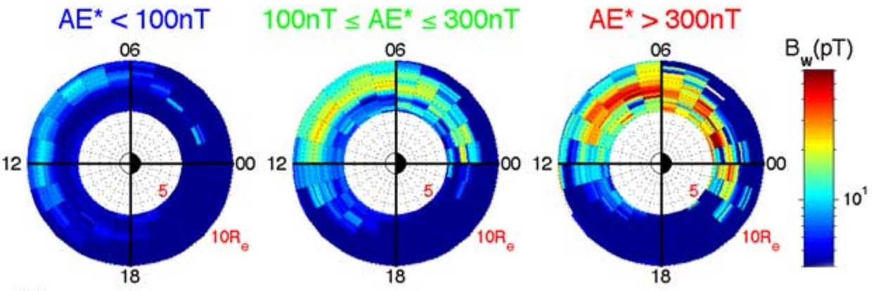
Correlation between Microburst and Chorus
Chorus waves
occur in a similar MLT region as microbursts
rising tone elements duration is similar to microbursts
This spatial similarity hints that chorus waves scatter microbursts
Not much is known about the microburst scattering mechanism
Li et al., 2009
Notes:
Same plot style as prior slide
Root mean squared wave power increases in the same region as microburst occurrences are observed to increase.
This plot is a correlation, and we need to do more work to find how microbursts are actually scattered.

Slide 15
The Microburst Scattering Mechanism
Why study the microburst scattering mechanism?
More accurately predict when microbursts occur and thus better predict their effects on the environment and human presence in space
Fill in missing physics of how waves and particles interact in the plasma
Determine if microburst scattering mechanism is a diffusive or not
Roadblocks
Very sparse data coverage
Microbursts and waves are not observed in the same place
Magnetic conjunction studies, e.g. Breneman et al., 2017, try to link the waves and microburst electrons but good conjunctions are rare
Our approach
Estimate the microburst size distribution and compare it to the wave distribution
Study the microburst scattering in-situ in the heart of the outer radiation belt
Notes:
Describe a magnetic conjunction and how it relies on magnetic field models.
Now I will present one study to estimate a microburst size in LEO and the magnetic equator to compare it to other waves.

Slide 16
Estimating the size of a bouncing packet microburst with FIREBIRD-II
Shumko, M., Sample, J., Johnson, A., Blake, B., Crew, A., Spence, H., ... & Handley, M. (2018). Microburst Scale Size Derived From Multiple Bounces of a Microburst Simultaneously Observed With the FIREBIRD‐II CubeSats. Geophysical Research Letters, 45(17), 8811-8818.

Slide 17
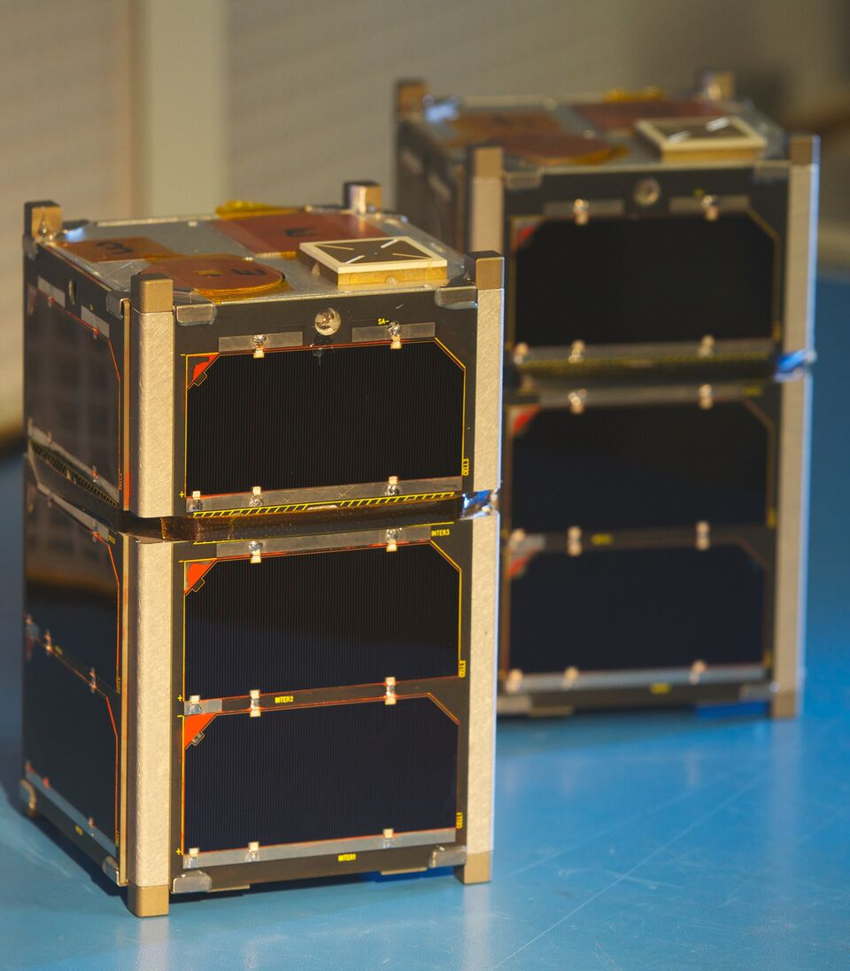
The FIREBIRD-II Mission
Build by MSU and University of New Hampshire
Pair of 1.5U CubeSats launched on January 2015 into 600x400 km, 99° inclination orbit
Separation in-track
Solid state detectors with six programmable energy channels observing electrons from 200 keV to > 1 MeV
Still operational and commanded by Arlo Johnson and me
Notes:
FIREBIRD == Focused Investigations of Relativistic Electron Bursts: Intensity, Range, and Dynamics
Pass around prop
Separated in a P-pod and first few days their separation was a few tens of km. Now it is about 8000 km.
In orbit for almost five years, almost as long as I’ve been in grad school!
One of the FIREBIRD science goals is to estimate the size of individual microbursts…
99 degree inclination is a polar and retrograde orbit. The spacecraft appears to move west instead of east

Slide 18
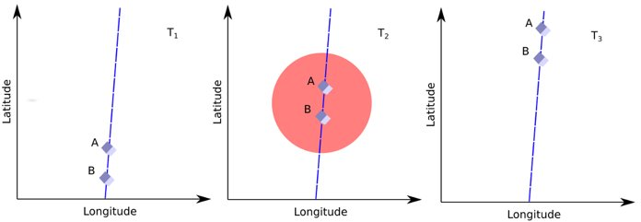
FIREBIRD-II’s Primary Science
Determine the size of microbursts
Crew et al., 2016 first reported > 11 km microbursts observed simultaneously by FIREBIRD-II
Soon after, we found a larger microburst
Notes:
When both FIREBIRDs observe a microburst, the microburst size must be larger than the spacecraft separation.
Mention the plot shows the three microbursts observed together.
Alex Crew estimated the FIREBIRD separation to be 11 km at this time.

Slide 19
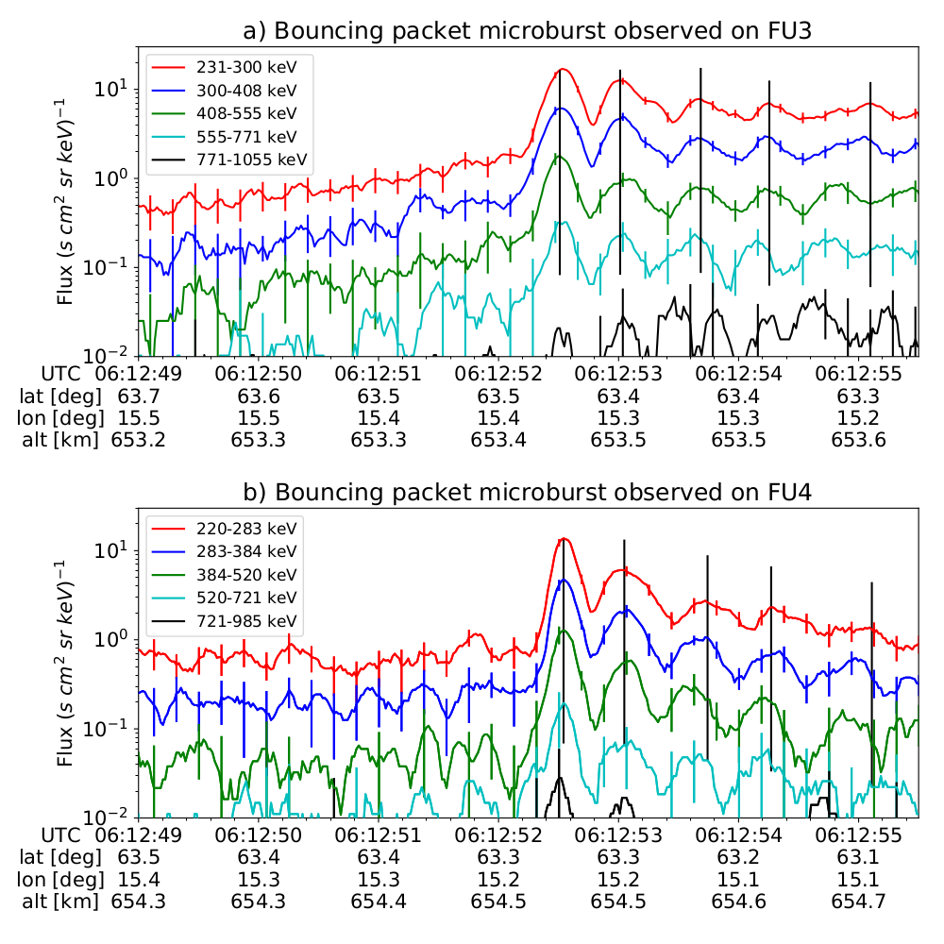
Microburst Observation
Microburst and subsequent bounces seen by both FIREBIRD-II units on February 2nd, 2015 above Sweden
Microburst electrons with energies up to 555-771 keV were scattered
FU3 and FU4 were separated by ≈ 20 km
Notes:
This is a bouncing packet microburst observed at the same time. I.e. the first peak is the intial microburst, and the subsequent peaks are from electrons bouncing on the field line.
Microbursts of energies up to approx 800 keV were scattered.
We use the orbit information as well as the time progression to estimate how big this microburst was.

Slide 20
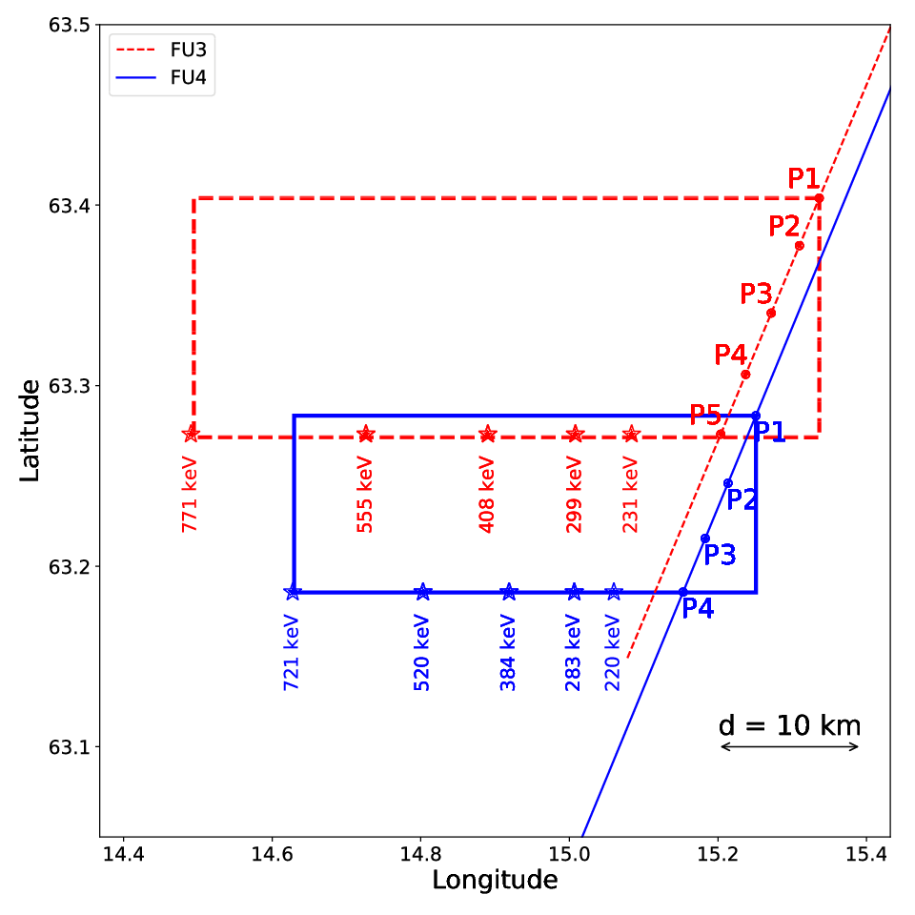
Microburst Size Estimated From Orbit Geometry
Used the spacecraft motion and energy-dependent electron drift to find microburst sizes
Microburst size in LEO
Latitudinal: > 29 ± 1 km
Longitudinal: > 51 ± 1 km
Microburst size at the magnetic equator
Radial: > 500 ± 10 km
Azimuthal: > 530 ± 10 km
Equatorial microburst size is similar to the whistler-mode chorus source scale sizes reported in [Agapitov et al., 2011, 2017]
Notes:
Made a map << EXPLAIN THE ORBIT TRACKS AND P# LABELS >>
Latitudinal size is just the dLat from FU3_P1 to FU4_P4 and is 30 km.
Longitudinal estimate uses the drift rates. We asked the question “How far to the west were the highest energy microburst electrons when we observed P1 such that they drifted to the FIREBIRD position for the last peak.” The drift is energy dependent and show illustrate the electron + FU3 motion with the pointer.
This is one case study. Up next I will describe how I estimated the microburst size distribution using the AeroCube-6 CubeSats.

Slide 21
Microburst Size Distribution Derived with AeroCube-6
M. Shumko, A.T. Johnson, J.G. Sample, B.A. Griffith, D.L. Turner, T.P. O’Brien, O. Agapitov, J.B. Blake, and S. G. Claudepierre (2019). Microburst Size Distribution Derived with AeroCube-6. Prepared for Journal of Geophysical Research

Slide 22
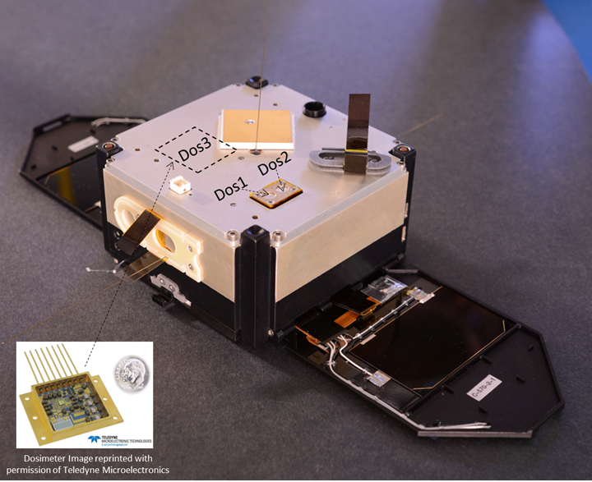
The AeroCube 6 (AC6) mission
Pair of CubeSats, launched in June 2014 into a 620x700km, 98 degree inclination orbit
Built by The Aerospace Corporation
Their separation is mostly in-track, and is controlled via differential drag
Dosimeters measure > 35 keV electrons
O’Brien et al. [TOR-2016-01155]
Notes:
AC6 orbit is similar to FIREBIRD’s.
Separation is mostly in-track and they spent a lot of time at less than 100 km separation which is the expected size of microbursts
Has advantages and disadvantages when compared to FIREBIRD: AC6 has controllable separation, while FIREBIRD has differential energy channels.

Slide 23
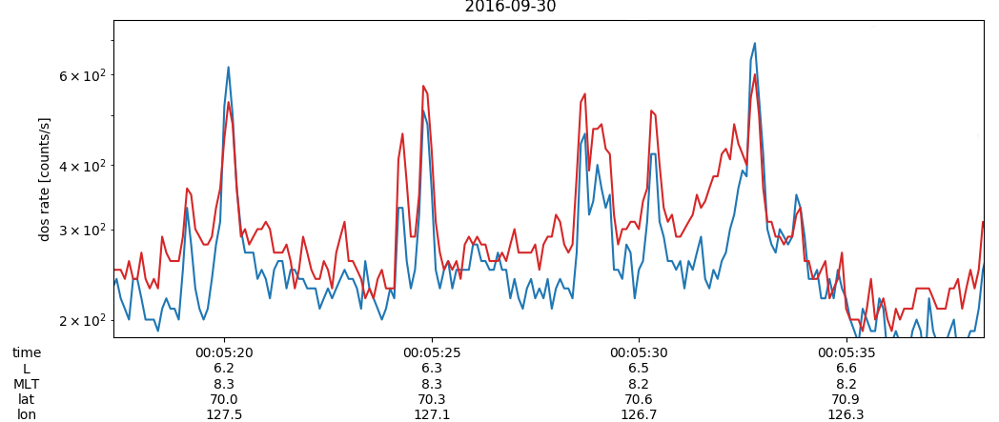
Idea Of The Study
AC6 has observed numerous coincident microbursts at varying separations
These detections can then be used to find the distribution of microburst sizes in low Earth orbit and the magnetic equator
The distributions of microbursts and waves can then be directly compared.
Notes:
Same principle as FIREBIRD observations and << EXPLAIN ILLUSTRATION >>.
An examples of microbursts observed at the same time by the two AC6 units is shown << MENTION BOTTOM PLOT >>.
Observe a bunch of microbursts and make a distribution of them in LEO and the magnetic equator.
Then compare to waves
First step is to identify microbursts in the data…

Slide 24
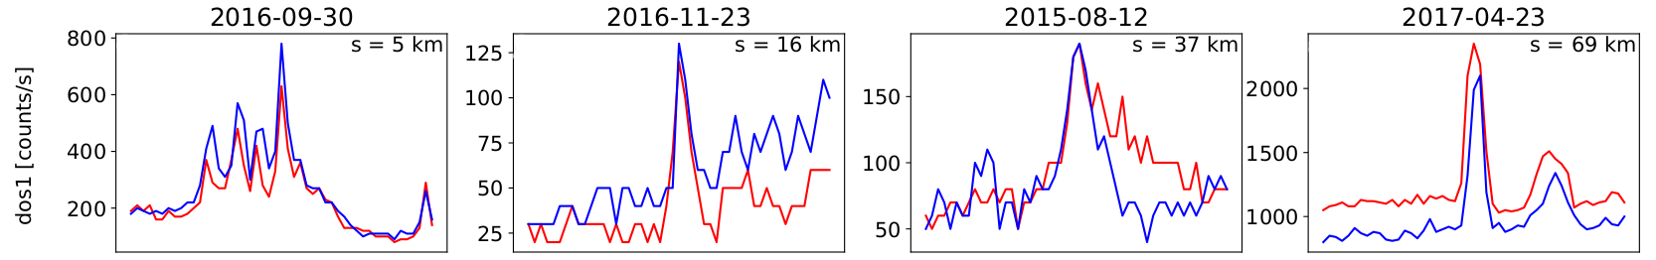
Microburst detection and event selection
Microbursts identified with the burst parameter [O'Brien et al., 2003] on each spacecraft
To find microbursts observed simultaneously by AC-6:
microburst data were correlated between the two spacecraft
microbursts with correlation > 0.8 were considered coincident
Notes:
Microbursts first identified individually using burst param – which has been successfully used in other studies.
Then microbursts were cross correlated. If a microburst CC with no microburst the CC is low, and CC with a microburst will be high.
Here are examples of microbursts observed at various separations up to 70 km.
Now we use these highly correlated microbursts to make the microburst distribution.

Slide 25
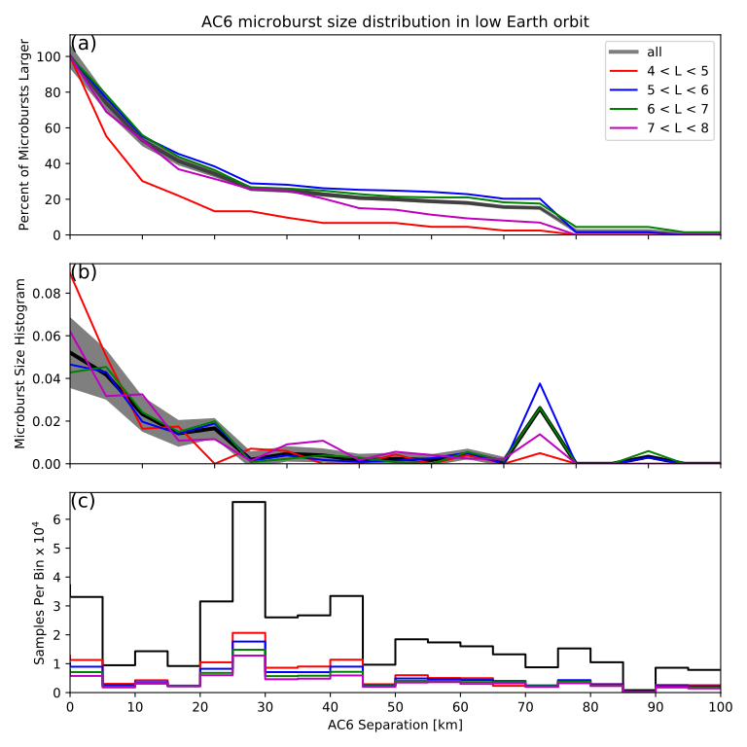
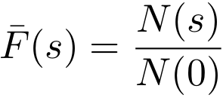
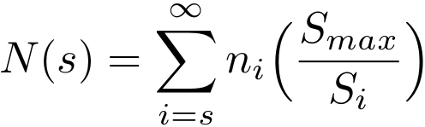
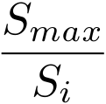
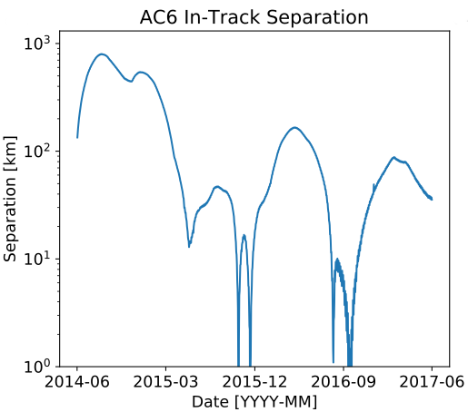
Microburst size distribution in low Earth orbit
Well-correlated microburst detections were used for the microburst size distribution
The cumulative fraction of microbursts observed above AC-6 separation, s is
The term is the normalization for the AC-6 separation
Right plot panels:
Top – microburst F(s)
Middle – microburst probability density
Bottom – Number of AC-6 samples in separation bin
Notes:
Now we use the dataset of correlated microbursts to FIRST estimate the microburst distribution in LEO, and THEN the magnetic equator in a few slides.
Used the complementary cumulative distribution function to calculate the percent of microbursts larger than the AC6 separation. << TALK ABOUT F(s) >>.
Binned the data into 5 km bins and counted the number of correlated microbursts.
This estimate is biased because AC6 did not spend equal amount of time at each separation << MENTION LOWER LEFT PLOT >>. Thus I corrected for this bias with the S_max/S_i scaling.
<< TALK ABOUT RHS PLOT >>
Top panel shows the distribution as a function of AC6 separation. Middle panel quantifies this and has evidence of two populations, observed at sub 20 km and 70-80 km AC6 separations.

Slide 26
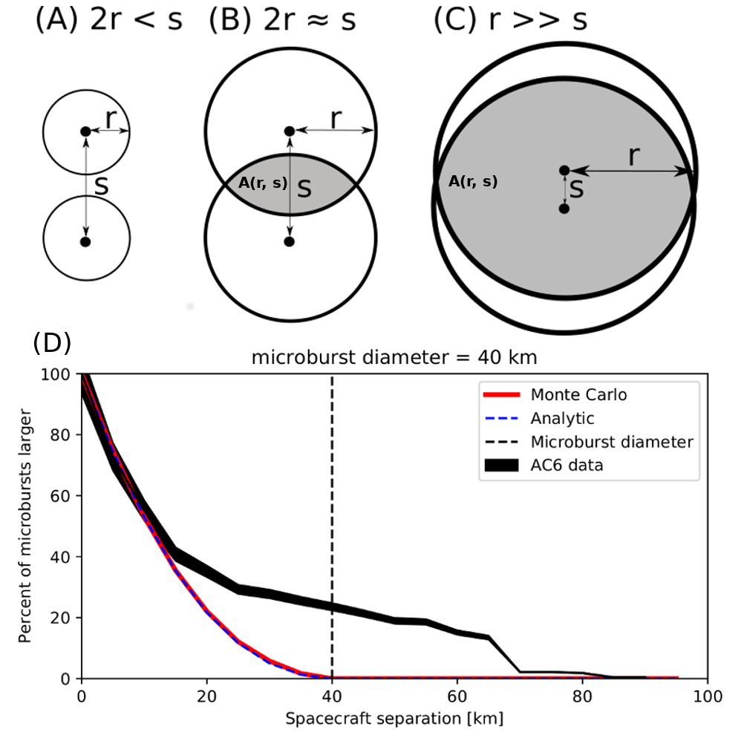
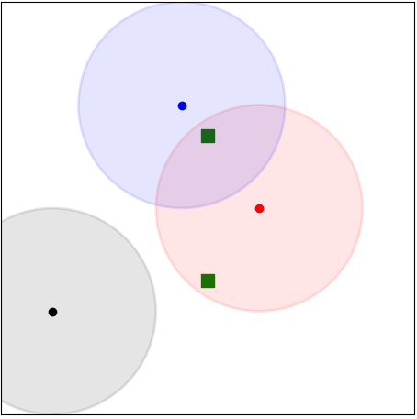
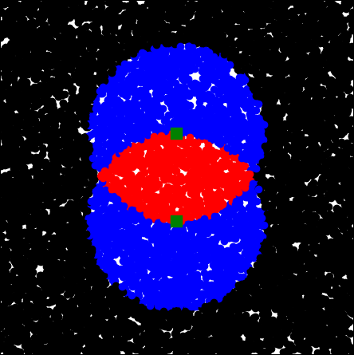
Modeling the Microburst Distribution
We have to do more work to make the microburst distribution more intuitive
The compounding effects due to random microburst locations and sizes were modeled assuming
Microburst occur randomly around AC6
Microburst footprint is circular
Prescribed microburst probability density function (PDF)
Notes:
Unfortunately (or fortunately) we have to do more work and model this distribution.
A Monte Carlo and analytic models were developed to account for the random microburst locations and sizes. Monte Carlo model is easy to implement and generalize, and the analytic model highlights the geometry.
These models are general and can account for continuous PDFs but we will investigate simpler, discrete PDFs that are easy to interpret.
<<POINT TO BOTTOM LEFT PLOT>> Three types of microbursts: one too far away to be seen, one observed by only one sc, and one observed by two spacecraft. <<POINT TO BOTTOM MIDDLE PLOT >> If we scatter a bunch of microburst circles and color code their centers, we get the following color distribution. This is the basis for the analytic model.
Now with all this, the << BOTTOM RIGHT >> panel shows the modeled fraction of microbursts given a one-size microburst population with a 40 km diameter. Also I superposed the AC6 data.
Both models are consistent. Mention that the fast drop off up to 20 km does not mean the microburst is 20 km while it is in fact 40 km. The departure of the data from the modeled F shows evidence of another microburst population. All in all, these microbursts may be bigger than they appear.
Now given a prescribed microburst PDF, what are the optimal model parameters? We use Bayesian inference and Markov Chain Monte Carlo.

Slide 27
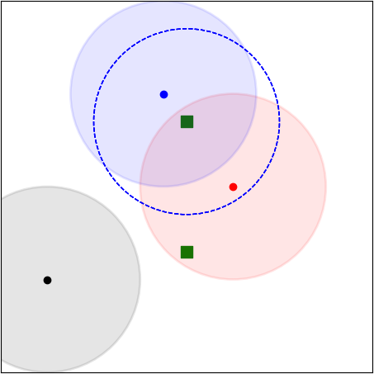
Modeling the Microburst Distribution
We have to do more work to make the microburst distribution more intuitive
The compounding effects due to random microburst locations and sizes were modeled assuming
Microburst occur randomly around AC6
Microburst footprint is circular
Prescribed microburst probability density function (PDF)
Notes:
Unfortunately (or fortunately) we have to do more work and model this distribution.
A Monte Carlo and analytic models were developed to account for the random microburst locations and sizes. Monte Carlo model is easy to implement and generalize, and the analytic model highlights the geometry.
These models are general and can account for continuous PDFs but we will investigate simpler, discrete PDFs that are easy to interpret.
<<POINT TO BOTTOM LEFT PLOT>> Three types of microbursts: one too far away to be seen, one observed by only one sc, and one observed by two spacecraft. <<POINT TO BOTTOM MIDDLE PLOT >> If we scatter a bunch of microburst circles and color code their centers, we get the following color distribution. This is the basis for the analytic model.
Now with all this, the << BOTTOM RIGHT >> panel shows the modeled fraction of microbursts given a one-size microburst population with a 40 km diameter. Also I superposed the AC6 data.
Both models are consistent. Mention that the fast drop off up to 20 km does not mean the microburst is 20 km while it is in fact 40 km. The departure of the data from the modeled F shows evidence of another microburst population. All in all, these microbursts may be bigger than they appear.
Now given a prescribed microburst PDF, what are the optimal model parameters? We use Bayesian inference and Markov Chain Monte Carlo.

Slide 28
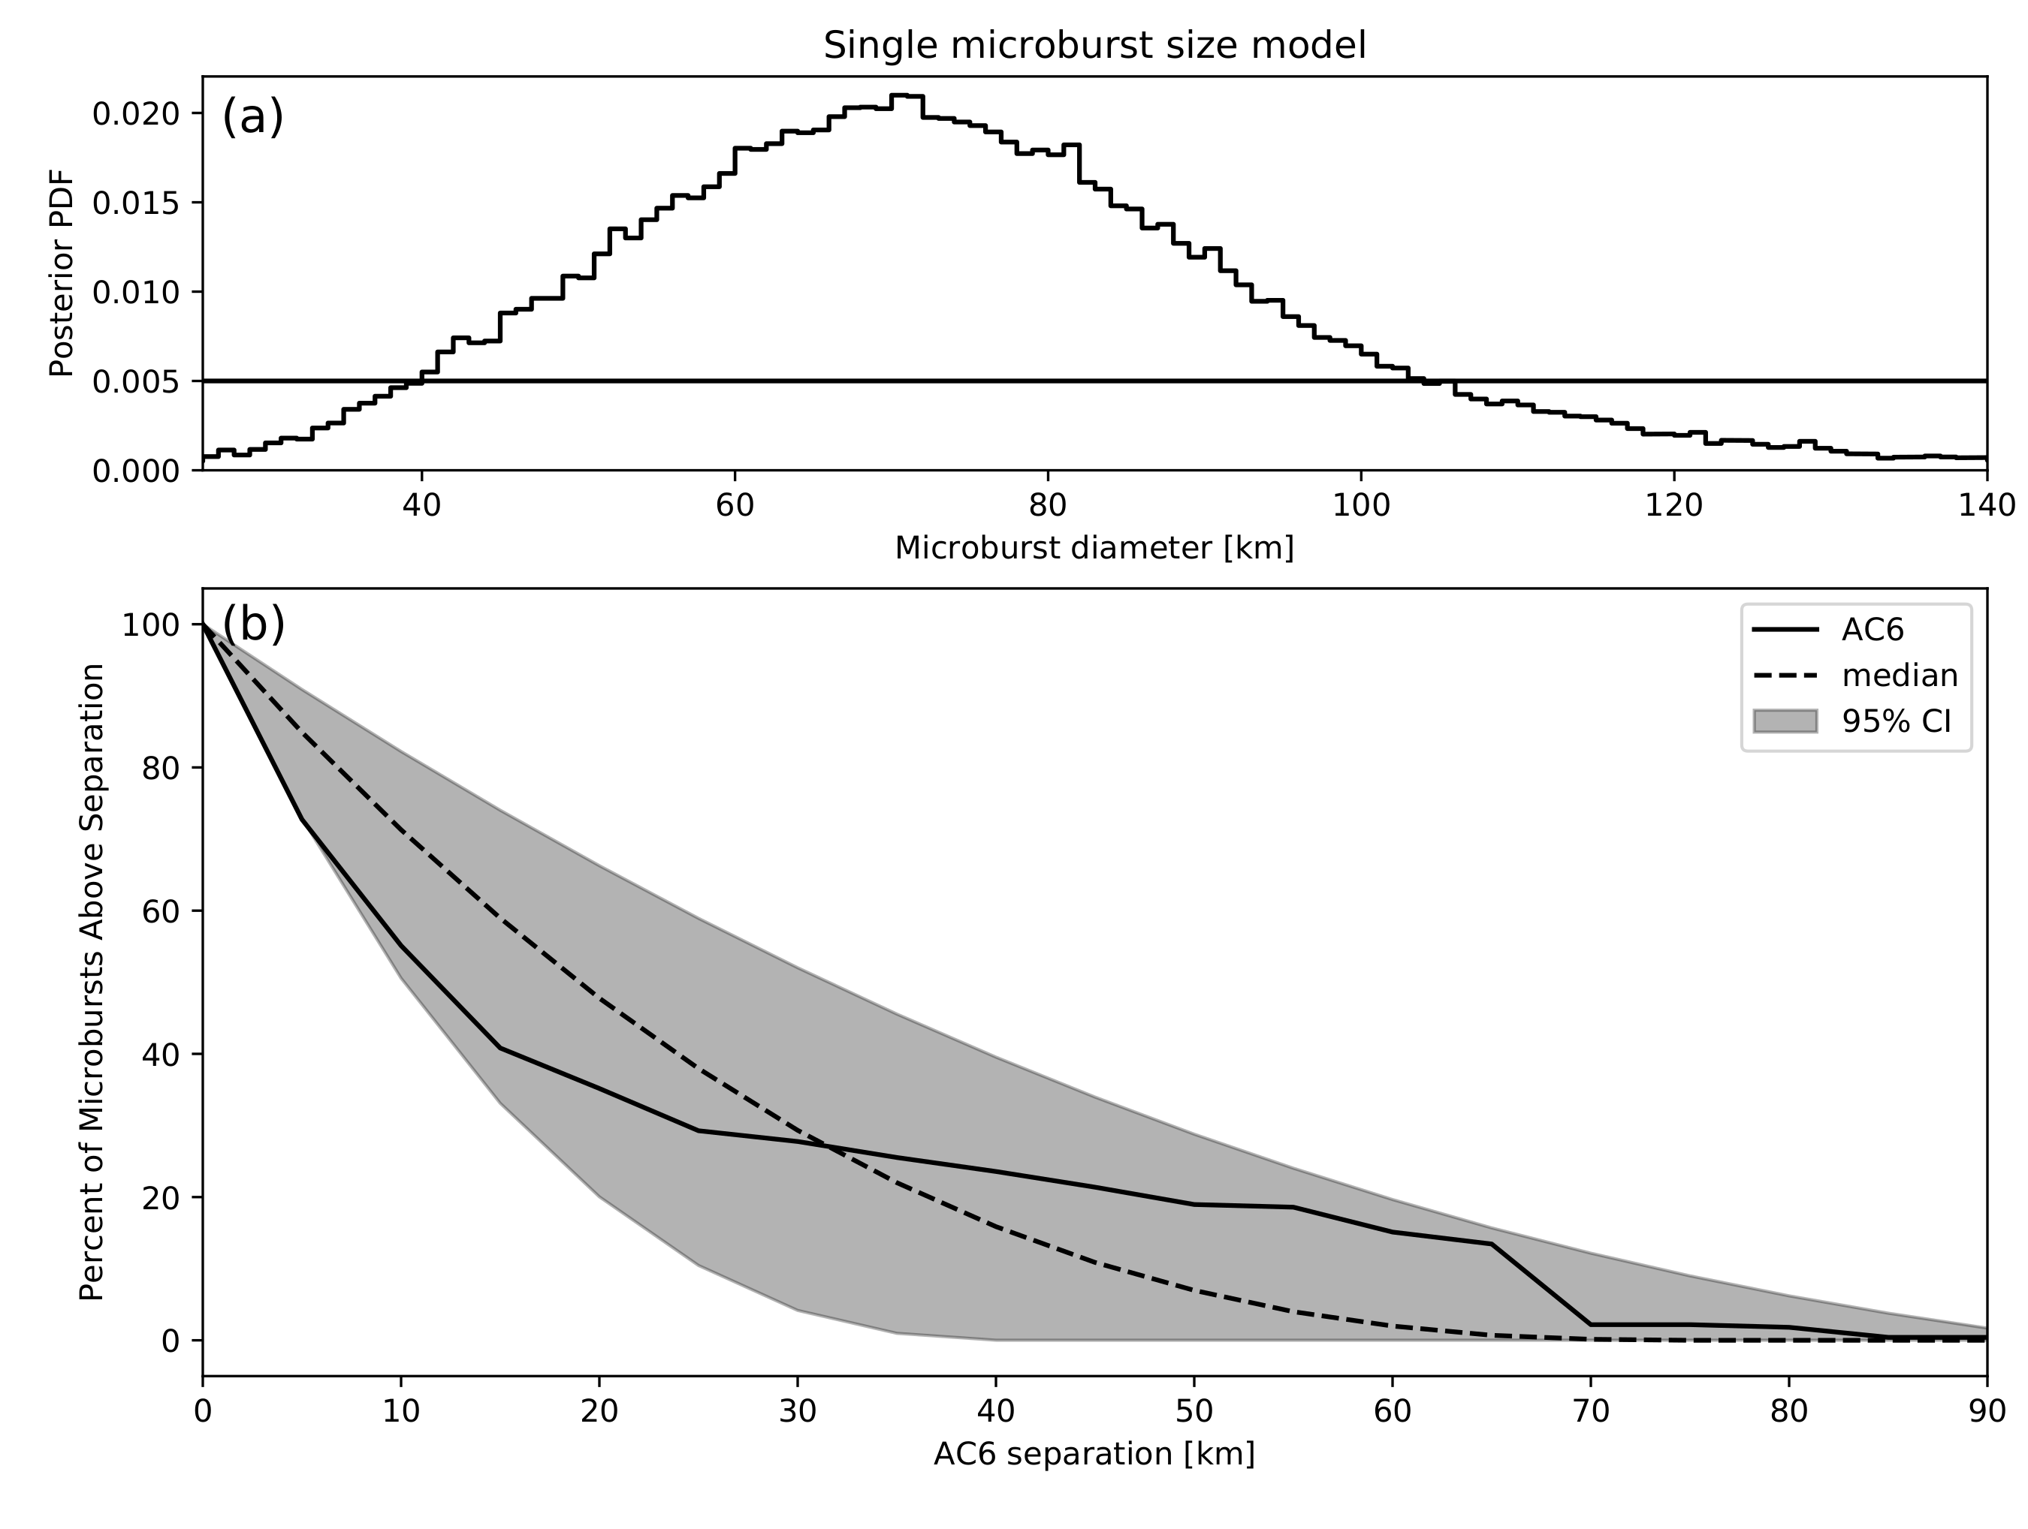
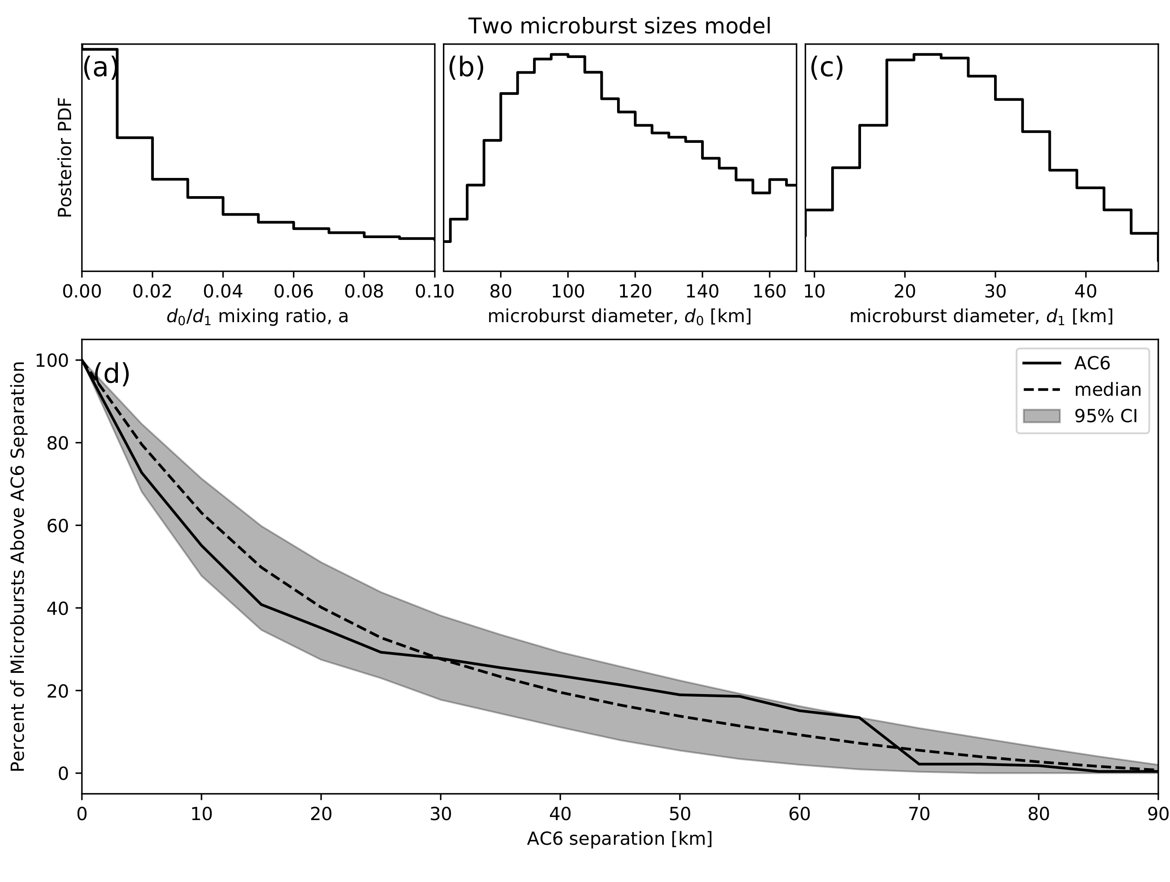
Modeling various hypothesized microburst size distributions
f(d|d₀) = δ(d-d₀)
Consistant range of d₀: 38-129 km | median 73 km
f(d|a, d₀, d₁)= aδ(d-d₀) + (1-a)δ(d-d₁)
0.1% < a < 16% | 12 < d₀ < 47 km | 76 < d₁ < 234 km
Notes:
Here we estimated the range of PDF parameters consistent with the data using a Markov Chain Monte Carlo.
<< TALK ABOUT ONE SIZE MODEL >>
We will estimate the range of microburst sizes consistent with the data assuming all microbursts are one size. The top panel shows the posterior PDF and the bottom panel shows the range of modeled cumulative distributions. <<TALK ABOUT THE VARIOUS LINES >>
<< TALK ABOUT THE TWO SIZE MODEL >>
Mention parameters and the same idea for the posterior PDF. The range of cumulative distributions. There is a tighter variance, but that is to be expected with two extra free parameters.
I also modeled simple continuous PDF distributions and the results are very similar. The current evidence supports a bimodal microburst distribution.

Slide 29
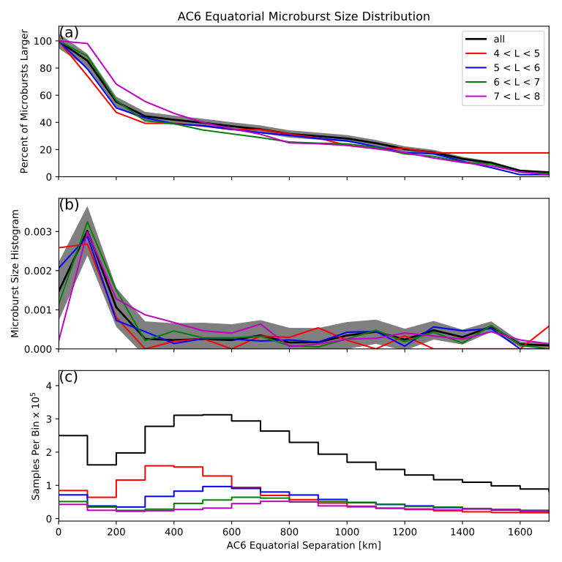
Microburst size distribution mapped to magnetic equator
Same procedure as the LEO distribution
Normalization is different
Most microbursts were generated in a < 200 km region
Implies that waves that scatter microbursts must have correlated properties on those spatial sizes
Notes:
At the end say… “Now how does this distribution compare to the distribution of waves?”

Slide 30
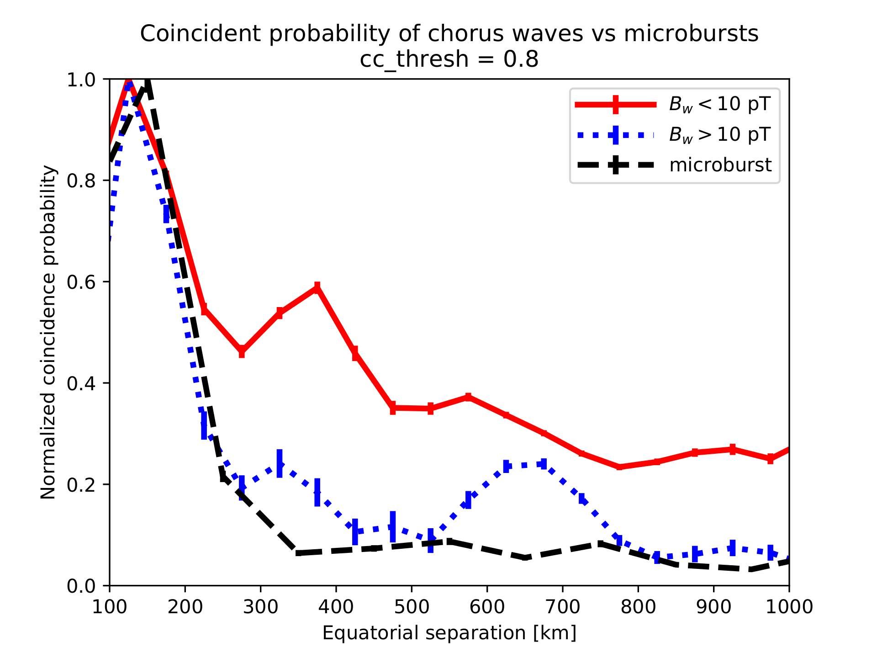
Preliminary Microburst vs Chorus Wave Distribution Comparison
Used a dataset from Agapitov et al., 2018
Chorus waves observed by the THEMIS mission were correlated
Waves were split up by low and high amplitude
The fraction of highly correlated chorus waves in each separation bin was calculated
Microburst distribution follows the high amplitude chorus waves more closely
Notes:
Wanted an apples to applies comparison so analyzed both datasets in the similar way.
Looked at if high or low amplitudes chorus waves correlate more with microbursts
In each AC6 or THEMIS separation bin, the fraction of highly correlated waves and microbursts -- CC > 0.8 -- was calculated.
Microburst distribution more closely follows the higher amplitude chorus waves
THEMIS == Time History of Events and Macroscale Interactions during Substorms
THEMIS is a NASA constellation mission on a highly elliptical orbit

Slide 31
Conclusions
Most microbursts observed for AC-6 separations less than a few tens of km
Majority of microbursts map to sizes less than 200 km at the magnetic equator
The equatorial microburst distribution better matches the high amplitude chorus wave distribution
Modeling the microburst size distribution is essential to understand the data
"We have to remember that what we observe is not nature herself, but nature exposed to our method of questioning." - Werner Heisenberg

Slide 32
Microburst scattering directly observed in the heart of the radiation belts
Shumko, M., Turner, D. L., O'Brien, T. P., Claudepierre, S. G., Sample, J., Hartley, D. P., ... & Mitchell, D. G. (2018). Evidence of microbursts observed near the equatorial plane in the outer van Allen radiation belt. Geophysical Research Letters, 45(16), 8044-8053.
Notes:
Now we switch gears a little bit and look at a microburst scattering observation made in the heart of the radiation belts where both the waves and particles were observed in-situ.

Slide 33
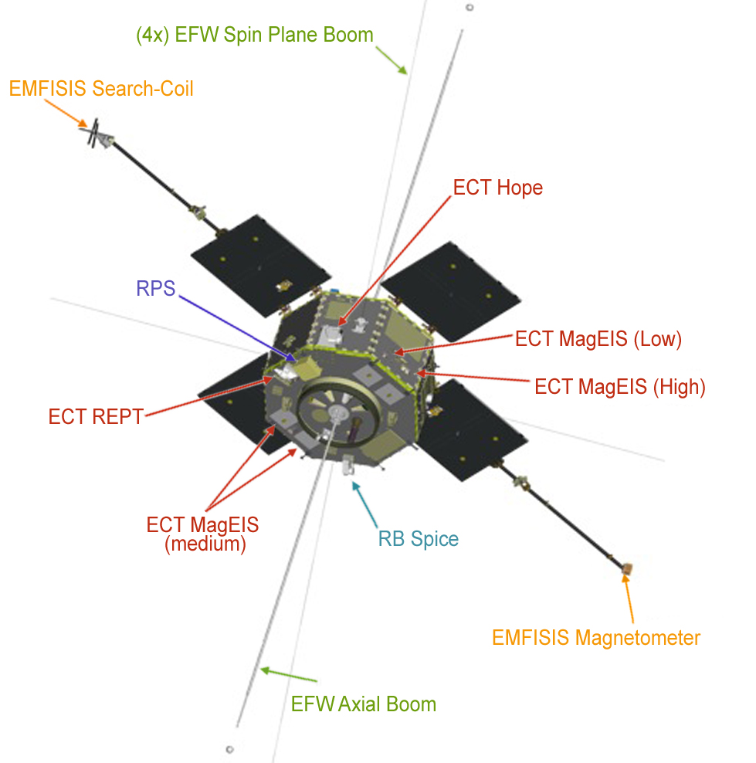
NASA's Van Allen Probes (RBSP)
Pair of identically instrumented satellites launched in August 2012
Orbit:
highly elliptical: 618 x 30,414 km
low inclination: 10.2°
Many instruments observing particles and waves
MagEIS
RBSPICE
EMFISIS
Spins with a 12 s period
Notes:
Low inclination so spends a long time near the magnetic equator near apogee.
Describe instruments:
MagEIS – One look direction
RBSPICE -- fan of 5 telescopes
The spin makes the data harder to analyze.

Slide 34
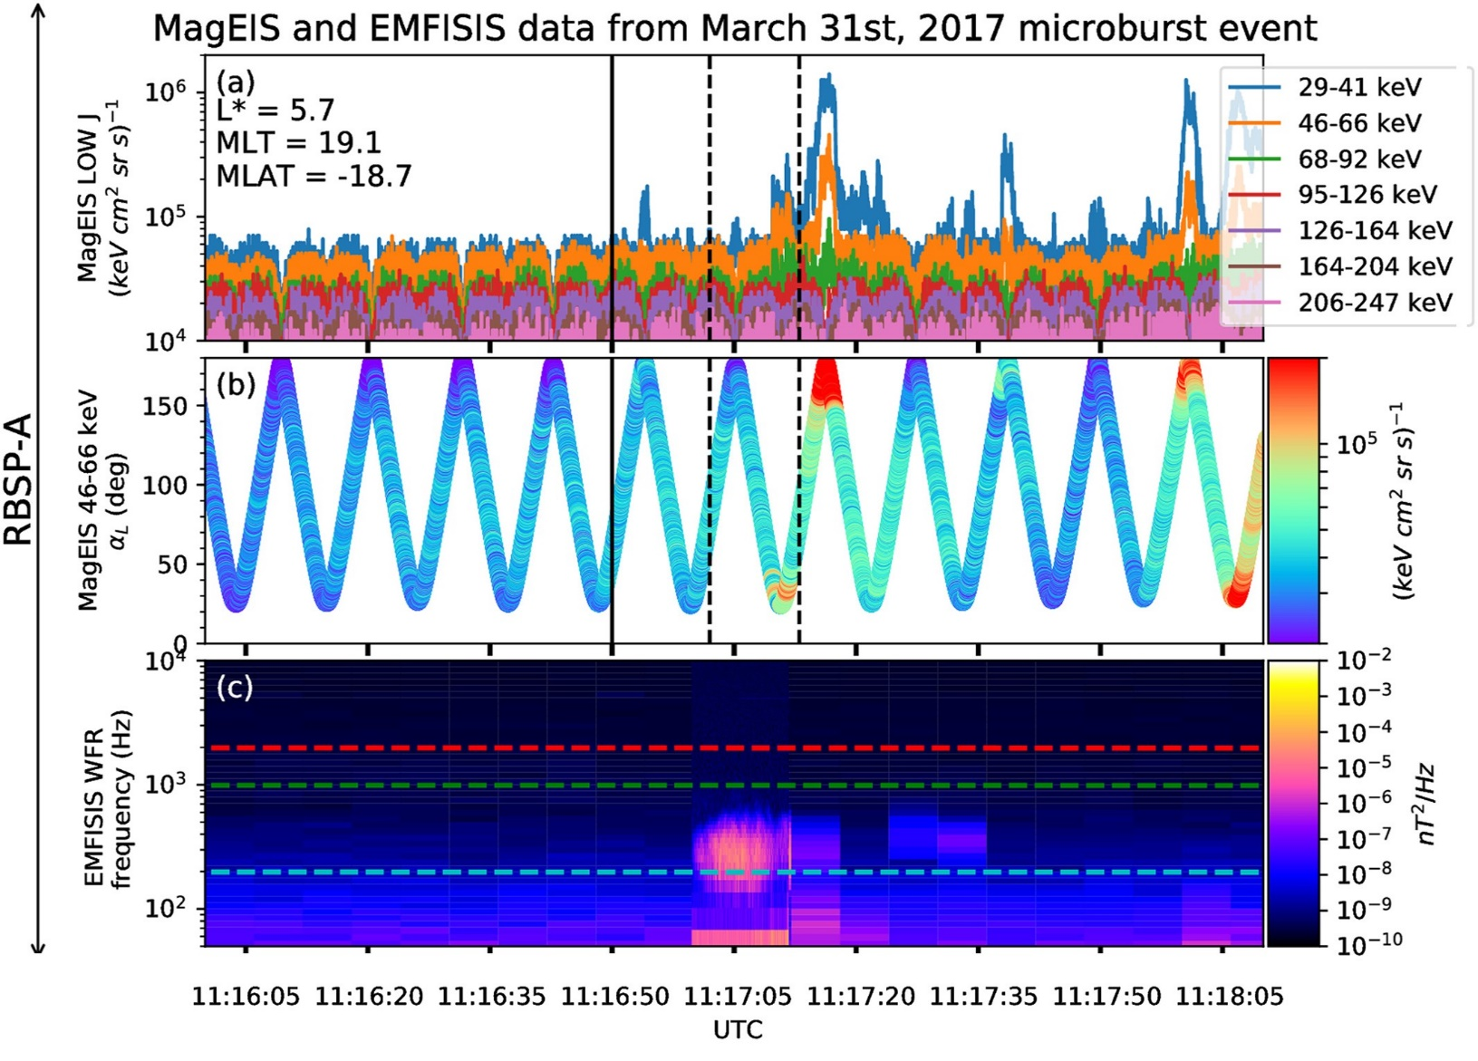
Microburst Observation
Microburst signatures observed 19° south of the magnetic equator
Microbursts observed by MagEIS and RBSPICE onboard RBSP-A
Strong wave power observed simultaneously in the lower band chorus frequency range
Notes:
Here is a overview of the microburst observation with a zoomed in plot in the next slide.
Microburst was observed by MagEIS and RBSPICE when RBSP-A was 19 degrees south of magnetic equator.
Strong wave power in the lower band chorus frequency range observed at this time.
<< DESCRIBE PLOTS >>
MagEIS flux timeseries with the microburst time bounded by vertical dashed black lines.
The local pitch angle evolution of the MagEIS instrument. MagEIS was looking near, but not quite in the 0 degree loss cone.
The EMFISIS spectrogram with the 0.1, 0.5, and 1 f_ce lines in cyan, green, and red. Wave power in the lower band chorus frequency range.
Now lets take a closer look at the particle data.

Slide 35
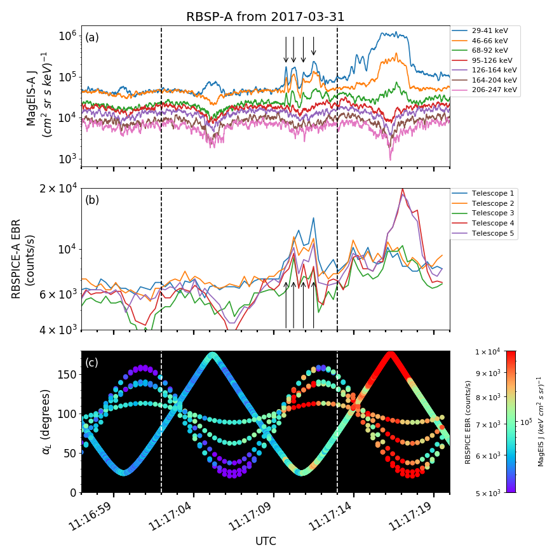
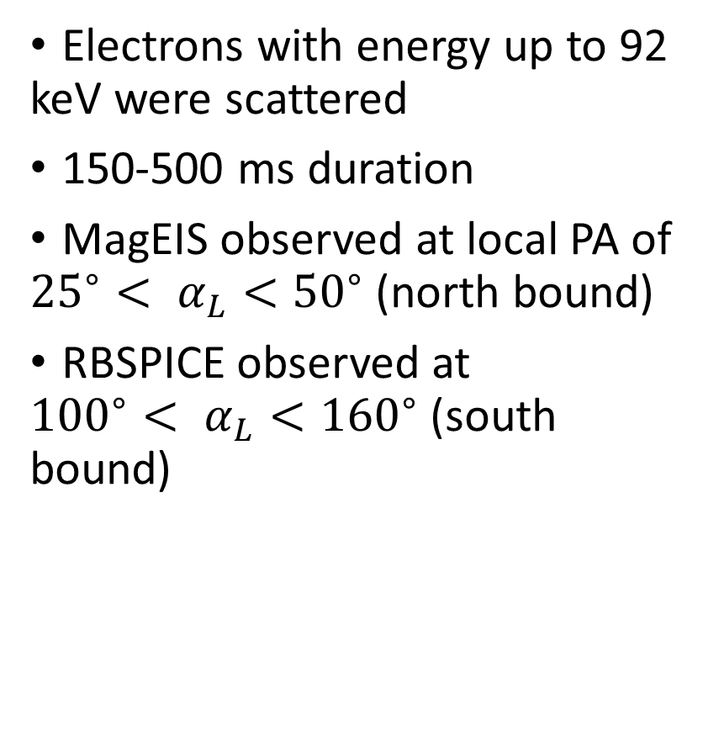
Microburst observation
Electrons with energy up to 92 keV were scattered
150-500 ms duration
MagEIS observed at local PA of ${{25}^{∘}< α}_{L}<{50}^{∘}$ (north bound)
RBSPICE observed at ${{100}^{∘}< α}_{L}<{160}^{∘}$ (south bound)
Notes:
Microbursts up to 92 keV (green trace) were scattered.
The duration was 150-500 ms, typicall of microbursts
<< TALK ABOUT PLOT >>
Mention MagEIS has energy resolution but one look direction
RBSPICE has integral energy above 19 keV and 5 different look directions.
Bottom panel shows the Pitch Angle scanning for RBSPICE and MagEIS at this time << SHOW THE FAMILY OF CURVES >>. MagEIS observed northbound traveling electrons between 25-50 PA and RBSOICE observed those electrons traveling south between 100-160 PA. The PA extent appears to be significant.
Now armed with this data we ask if the microburst scattering can be explained by a diffusion process.

Slide 36
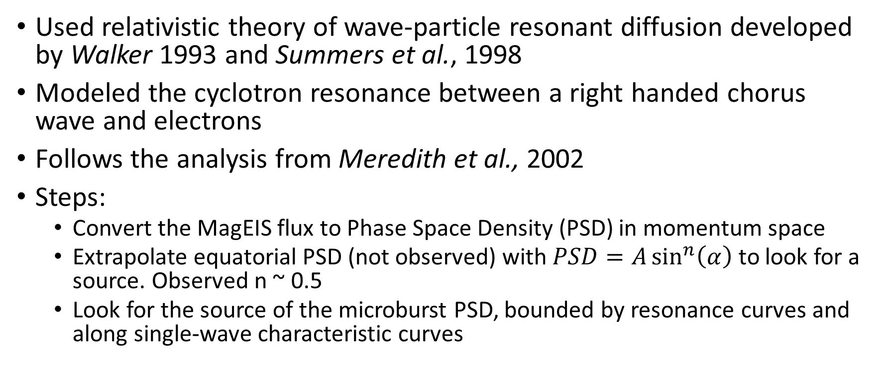
Model the scattering
Used relativistic theory of wave-particle resonant diffusion developed by Walker 1993 and Summers et al., 1998
Modeled the cyclotron resonance between a right handed chorus wave and electrons
Follows the analysis from Meredith et al., 2002
Steps:
Convert the MagEIS flux to Phase Space Density (PSD) in momentum space
Extrapolate equatorial PSD (not observed) with $PSD=A\sin^{n}\left(α\right)$ to look for a source. Observed n ~ 0.5
Look for the source of the microburst PSD, bounded by resonance curves and along single-wave characteristic curves
Notes:
STEP 1: When converted to PSD, the angle is the pitch angle and
RBSP-A was 19 degrees off the equator so all electrons that mirrored closer to the equator were not observed. Those electrons were probably the source. This means we need to apply an extrapolation. We will look at how extreme of an interpolation we need to get enough microburst PSD.

Slide 37
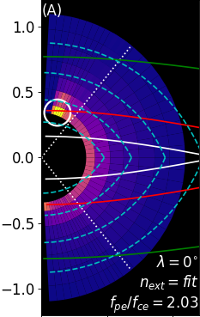
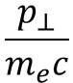
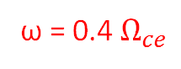
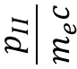
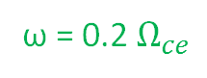
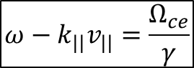

Resonance and Single Wave Characteristic Curves
Electron Cyclotron Resonance with Whistler Mode Waves (Parallel)
$$ω−k_{||}v_{||}=\frac{Ω_{ce}}{γ}$$
Colors: observed phase space density
White circle: microburst PSD
Boundary: observed/extrapolated PSD
$$\frac{p_{II}}{m_{e}c}$$
ω = 0.2 $Ω_{ce}$
Resonance curves Resonance condition describes a family of curves in momentum space for which e⁻ are in cyclotron resonance with wave of frequency ω
ω = 0.4 $Ω_{ce}$
ω = 0.6 $Ω_{ce}$
Single Wave Characteristic curves Trajectories along which e⁻ will move due to interaction w/whistler mode waves over some frequency range
Cyclotron Resonance e⁻ diffuse from high to low PSD along the single wave characteristic curves
If in the direction of increasing energy: e⁻ gain energy/wave loses energy
If in the direction of decreasing energy: e⁻ lose energy/wave gains energy
$$\frac{p_{⊥}}{m_{e}c}$$
Notes:
This is a busy plot, and we will go through this one step at a time.
The colors up to the dotted white lines is the observed PSD with the microburst shown in yellow and circled.
The white dotted boundary shows the chuck of the equatorial PA that we did not observe since RBSP-A was off the equator.
The resonance curves highlight the region of PSD where electrons will be in resonance with the wave << POINT TO EQUATION >>.
The dashed cyan curves show the single wave characteristics – trajectories along which resonant particles will move. If increase PA electron will gain energy at the expense of the wave and vice-versa.
The extrapolated PSD shown here is from a fit to the data. We don’t see any source of microburst PSD and we will now crank up the n parameter.
Now we explore the parameter space as a function of the scattering latitude and the PSD extrapolation

Slide 38
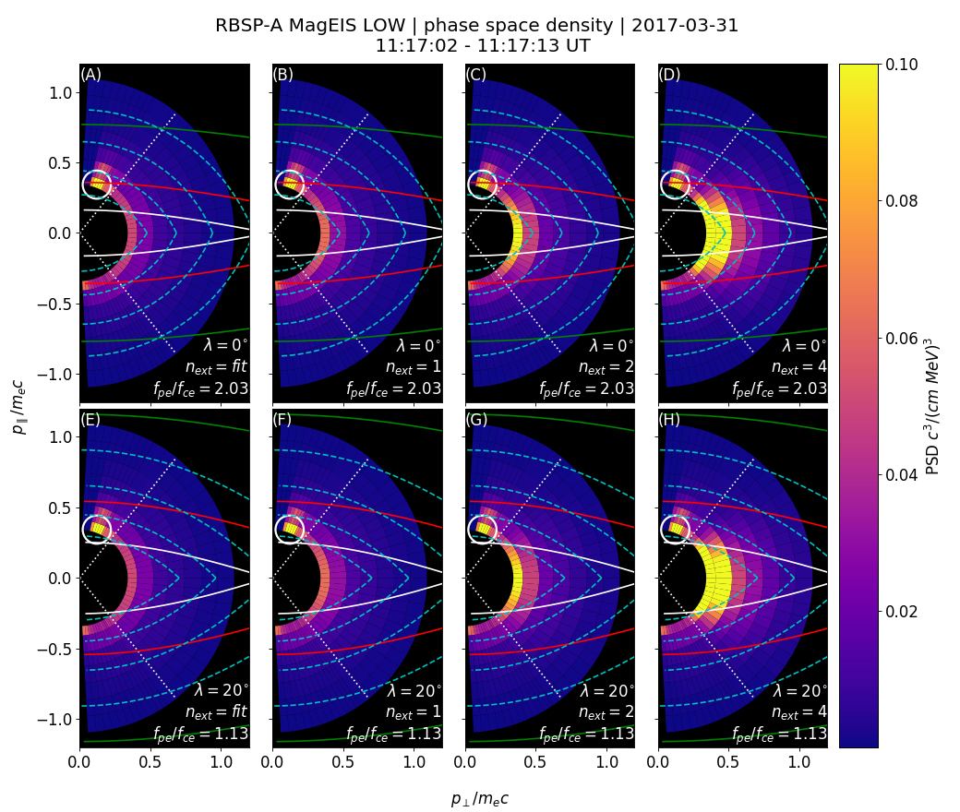
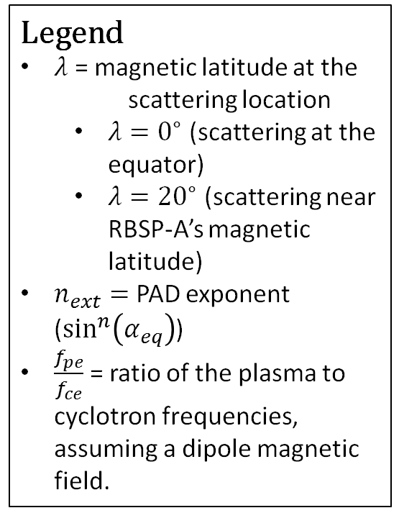
Explore Various Model Parameters
Legend
$λ$ = magnetic latitude at the scattering location
$λ=0^{∘}$ (scattering at the equator)
$λ={20}^{∘}$ (scattering near RBSP-A’s magnetic latitude)
$n_{ext}=$ PAD exponent ($\sin^{n}\left(α_{eq}\right)$)
$\frac{f_{pe}}{f_{ce}}$ = ratio of the plasma to cyclotron frequencies, assuming a dipole magnetic field.
Notes:
Rows: different scattering latitude, near the equator and the spacecraft. Changes magnetic field hence the curves.
Columns show the different PDS extrapolation (background colors change). Use the fit n~0.5, and also 1, 2 and 4.
Looks like you need an n = 4 to even have enough PSD to scatter along characteristic curves.
This is approximately 10x larger than observed! Does not seem plausible.

Slide 39
Conclusions
Microburst electrons do not appear to have been transported along single wave characteristic curves
Need 5-10x more PSD near the magnetic equator than estimated from the data
These microbursts may have been generated during wave generation e.g. Hikishima et al., 2010
Observations of microbursts at the magnetic equator allows us to study the wave-particle interactions in-situ. No need for conjunction studies
Notes:
Now on to a few follow on projects that can be done

Slide 40
Path Forward
Use the AC-6 data to study correlated stationary structures e.g. "curtains" [Blake et al., 2016]
Test the hypothesis that curtains are microburst remnants drifting around the Earth
Detailed study comparing the microburst and wave sizes
Generalize to other waves and particle precipitation [e.g. Agapitov et al., 2018 and Blum et al., 2017]
A statistical study of microbursts and waves observed in-situ with the Van Allen Probes
Notes:
AC6 data was correlated in time, but I also saved the spatial correlation so we can look at the persistence of stationary structures like curtains.
A more careful study comparing the AC6 microbursts with waves. Can also generalize this to other precipitation and waves.
More microbursts have been identified with RBSP. The few cases I’ve seen were also observed with waves. A statistical study can look for similarities between these microbursts and microbursts observed in LEO.

Slide 41











Acknowledgements
"If I have seen further it is by standing on the shoulders of Giants." - Isaac Newton

Slide 42
Backup Slides

Slide 43
Microburst Size Estimated From FIREBIRD-II

Slide 44


"FUX fit" curves calculated using the time difference between peak maxima
"FU3 minima" curve calculated using the time differences between peak minimums
Drift rates

Slide 45
Markov Chain Monte Carlo

Slide 46
Bayes Theorem
P(A|B) = P(B|A)P(A)
P(B)
Derivation:
If events A and B are independent, then the probability of events A and B happening, P(A, B) = P(A)P(B).
But if events A and B are dependent, then P(A, B) = P(B)P(A|B). In other words, it is the probability of B happening multiplied by probability of A happening IF B has happened.
Since A and B are interchangeable, P(B, A) = P(A, B) -> P(B)P(A|B) = P(A)P(B|A). Rearrange and you get P(A|B) = P(B|A)P(A)/P(B)

Slide 47

Metropolis–Hastings MCMC Sampler
Choose an arbitrary starting point, x₀ in parameter space
For each iteration i in N trials,
Propose a new x_{i} using a random distribution e.g. normal centered on x_{i-1}
Calculate the posterior probability for x_{i} and x_{i-1} and the ratio
α = P(x_{i})/P(x_{i-1})
If α > 1, accept the proposal
Otherwise generate a random number u between 0 and 1. If u < α accept the proposal, otherwise reject it and pick a new proposal

Slide 48
Analytic Derivation of The Microburst Fraction

Slide 49


Slide 50



Slide 51
Continuous Microburst Size PDF Models

Slide 52

Maxwell Microburst PDF

Slide 53

Weibull Microburst PDF

Slide 54

Log-normal Microburst PDF

Slide 55
Single Wave Characteristics Derivation

Slide 56



Slide 57
Charged Particle Motion in Magnetic Fields

